Slide 1
Bayesian agent-based model of infectious disease transmission in an urban center
Alexis Grangier -- 229735
Anna Jurek -- 26176340

Slide 2
Entities and state variable
Individuals | Health Ministry
Susceptible (not infected) | No alert
Incubating | Alert state 1 (lowly coercive measures)
Infectious asymptomatic | Alert state 2 (medium coercive measures)
Infectious symptomatic | Alert state 3 (highly coercive measures)
Recovered (immune for 6 months)
Dead

Slide 3
Individual Agent Attributes
Each agent carries the following properties, fixed at initialization
🏘
🏢
👥
residence
work_place
age_group
Residential zone assigned at initialization and fixed throughout the simulation
Work zone assigned at initialization and fixed throughout the simulation
Age bracket of the agent; directly affects the individual fatality rate
🚌
📢
🩺
transport_pref
sensibility_plan
doctor
Preferred mode of transport when commuting to work each morning
Responsiveness to public health campaigns; drawn from a residence-level prior at initialization
Binary flag — whether the agent visits a doctor when symptomatic; doctor always reports to the health ministry

Slide 4
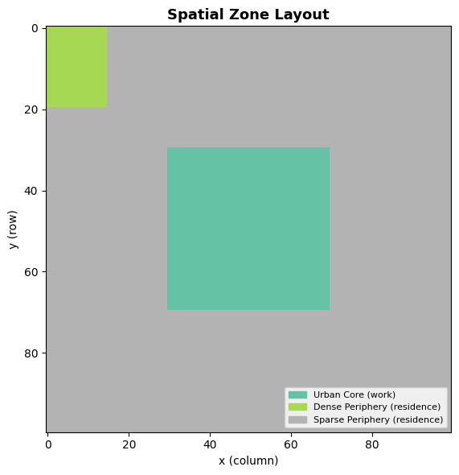
Environment and scales
730 ticks over 365 days
Spatial zone: 100 x 100 (max 5 agents per cel
Population size: 5000
Every 2 ticks daily aggregate case update

Slide 5
Design Concepts
🌊
🔄
👁
Emergence
Adaptation
Sensing
Timing and strength of epidemic waves, and activation of public health interventions, arise from bottom-up agent behavior.
Agents reduce commuting probability in response to active health plans set by the ministry.
Asymptomatic agents are unaware of their infectious state. Symptomatic agents know they can infect others.
🎲
👥
📊
Stochasticity
Collectives
Observation
Infection events, state transitions, mobility decisions, and medical consultations use Bernoulli trial random draws.
Residents of the denser periphery have lower responsiveness to containment measures, reflecting socio-economic info asymmetry.
Newly infected, susceptible, exposed, infected, recovered and dead agents counted at every step. Peak incidence and timing recorded.

Slide 6
Calibration

Slide 7
APP
<link>

